Slide 1
ILS Z-534 Information Retrieval Theory and Practice
Final project
Text Classification on Yelp Dataset
Team Members:
Naveen Shanmugasundaram
Niranjan Pachaiyappan
Venkatesh Thirupathisamy
Vignesh Vijayaraghavan

Slide 2
Task 1 : Classification of Business Categories
Implementation Method
Business are classified based on tips text .
403,210 tips grouped for approx. 29903 distinct business id(s).
15 Business categories considered.
Text Classification by Multinomial Naïve Bayes
Five fold Cross Validation implemented.

Slide 3
Task 1 - Implementation
File Conversion:
Conversion of tip text data from JSON to csv done using python parser.
Conversion of business data from JSON to csv done using python parser.
Data Integration/ Aggregation:
Different Tips for one business id integrated using “Talend” aggregator
function
Categories mapped to business id merged with tips using “Talend” mapping
function
Preprocessing using Weka :
Used “StringToWord Vector” class of weka to create feature space.
Information gain used to select attributes/ features from attribute selection filter.

Slide 4
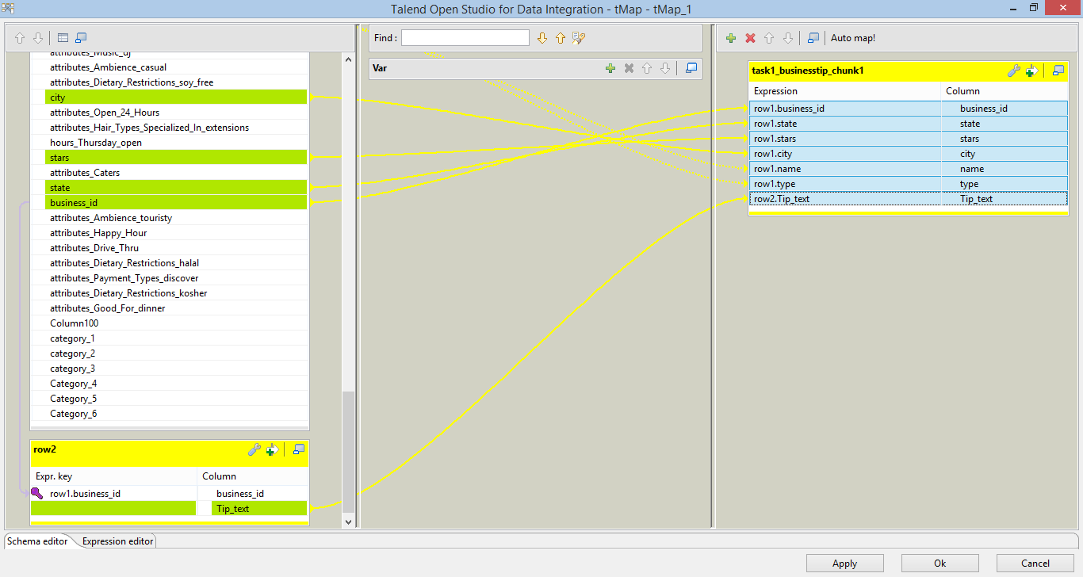
Talend Mapper

Slide 5
Task 1 – Results : Unigram
Instances: 7217 Attributes: 1122
Multi Nominal Naïve Bayes
SVM
Results | Values
Accuracy | 78.3982 %
Precision | 0.823
Recall | 0.784
False Positive Rate | 0.784
True Positive Rate | 0.047
Results | Values
Accuracy | 76.7632 %
Precision | 0.779
Recall | 0. 768
False Positive Rate | 0.208
True Positive Rate | 0.768

Slide 6
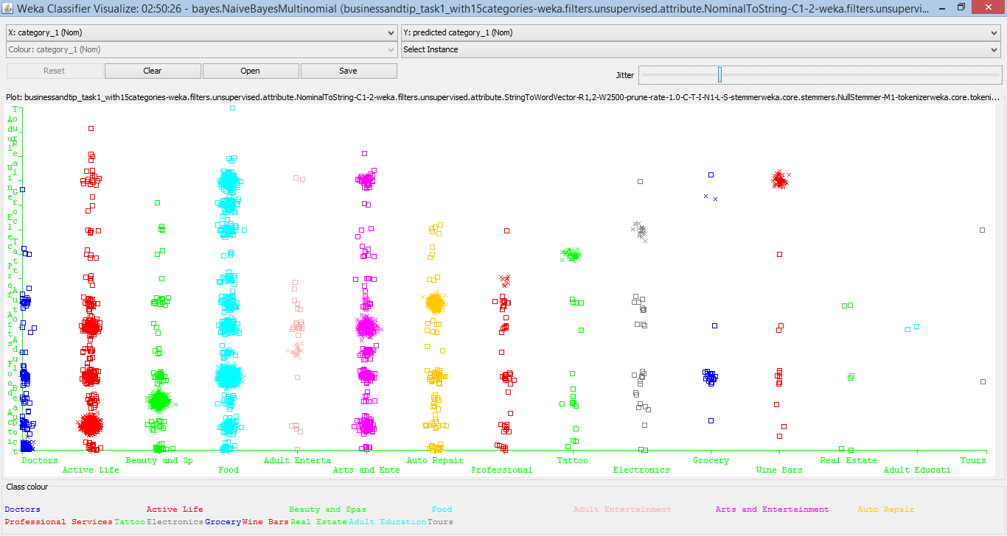
Task 1 – Results : Unigram (cont…)
Classification Error Graph for MultiNomial Naïve Bayes

Slide 7
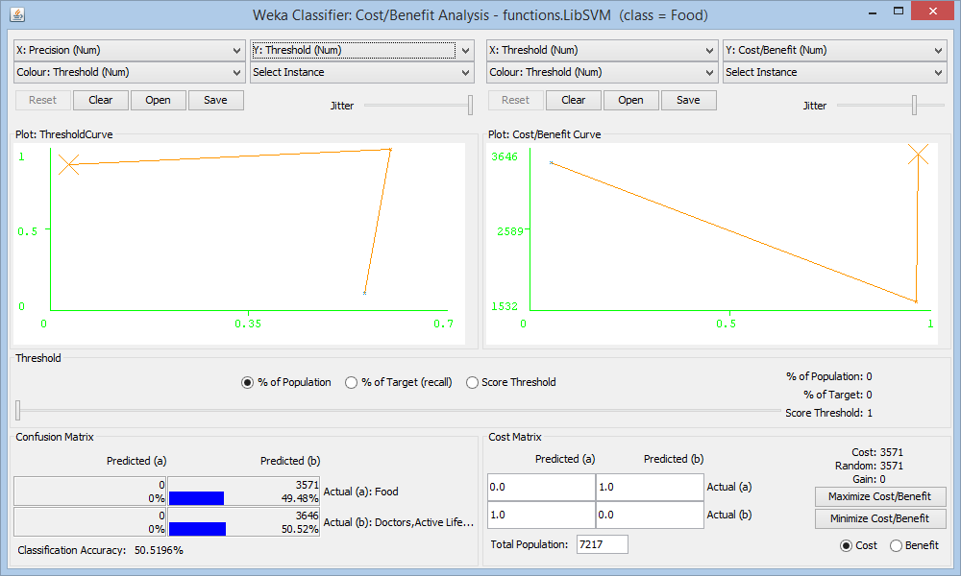
Task 1 – Results : Unigram (cont…)
Cost Benefit Graph for MultiNomial Naïve Bayes(Food Category)

Slide 8
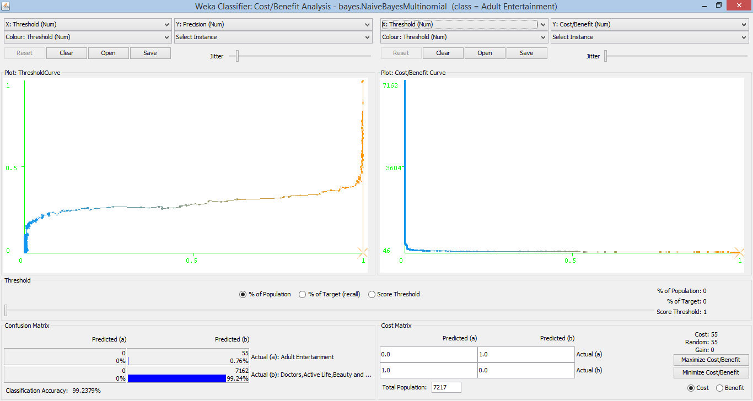
Task 1 – Results : Unigram (cont…)
Cost Benefit Graph for MultiNomial Naïve Bayes(Adult Entertainment Category)

Slide 9
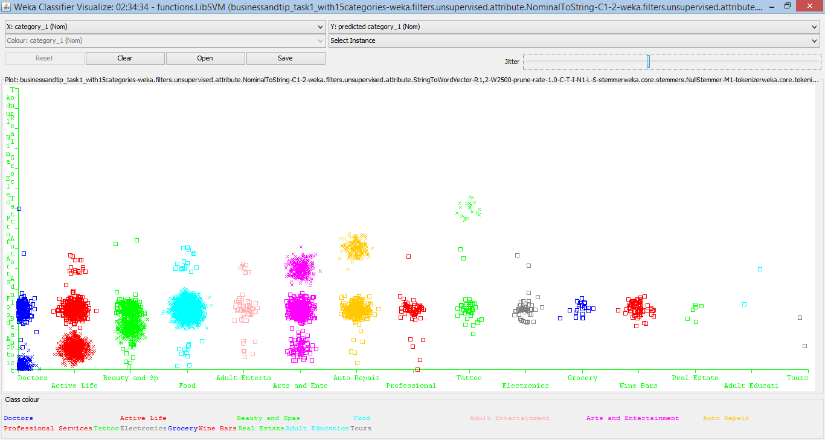
Task 1 – Results : Unigram (cont…)
Classification Error Graph for Support Vector Machine

Slide 10
Task 1 – Results : Unigram (cont…)
Cost Benefit Graph for Support Vector Machine(Food Category)

Slide 11
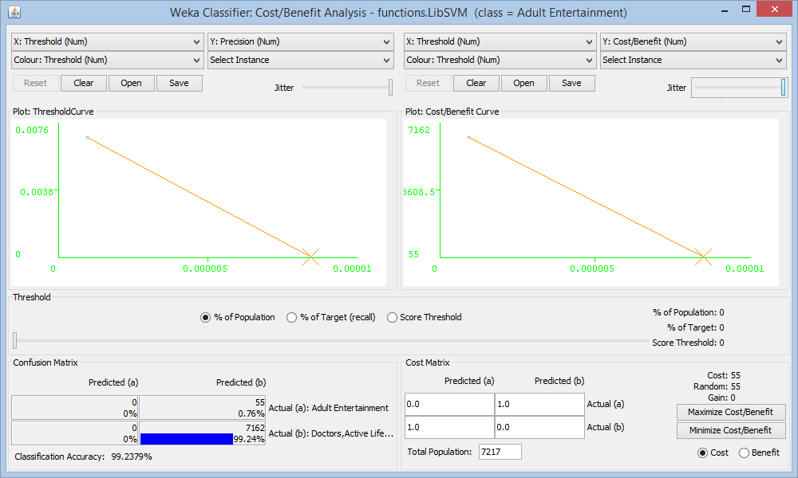
Task 1 – Results : Unigram (cont…)
Cost Benefit Graph for Support Vector Machine(Adult Entertainment Category)

Slide 12
Task 1 – Results : BIgram
Instances: 7217 Attributes: 252
Multi Nominal Naïve Bayes
SVM
Results | Values
Accuracy | 70.0568 %
Precision | 0.693
Recall | 0.701
False Positive Rate | 0.148
True Positive Rate | 0.701
Results | Values
Accuracy | 61.2581 %
Precision | 0.669
Recall | 0. 613
False Positive Rate | 0.374
True Positive Rate | 0.613

Slide 13
Task 1 – Results : Trigram
Instances: 7217 Attributes: 252
Multi Nominal Naïve Bayes
SVM
Results | Values
Accuracy | 57.711 %
Precision | 0.576
Recall | 0.577
False Positive Rate | 0.360
True Positive Rate | 0.577
Results | Values
Accuracy | 54.8012 %
Precision | 0.631
Recall | 0. 548
False Positive Rate | 0.439
True Positive Rate | 0.548

Slide 14
Task 2 - Predicting the rating from user review
Implementation Method
2% of review text(approx. 27000 records) used for Text Classification
Text Classification by Multinomial Naïve Bayes
Five fold Cross Validation implemented.
Final Class label will contain High and Low rating
Rating < 3 in review data considered as low rating.
Rating > =3 in review data considered as high rating.
SVM (Support Vector Machine) is also used to predict level of rating .
SVM and Multinomial Naïve Bayes results compared with each other.

Slide 15
Task 2 – Data Cleansing and Transformation
Conversion of review text data from JSON to csv using python parser.
Extracted/ Isolated the review text, voting and rating columns from the data
Voting considered includes cool, funny and useful.
Rating having values 1 and 2 are replaced with “Low Rating”
Rating having values 3, 4 and 5 are made “High Rating”
Preprocessing: using Weka :
Used “StringToWord Vector” class of weka to create feature space.
Information gain used to select attributes/ features from attribute selection filter.

Slide 16
Task 2 – Results : Unigram
Instances: 27844 Attributes: 142
Multi Nomial Naïve Bayes
SVM
Results | Values
Accuracy | 62.6957 %
Precision | 0.609
Recall | 0.627
False Positives | 0.480
True Positives | 0.627
Results | Values
Accuracy | 64.9763 %
Precision | 0.670
Recall | 0. 650
False Positives | 0.571
True Positives | 0.650

Slide 17
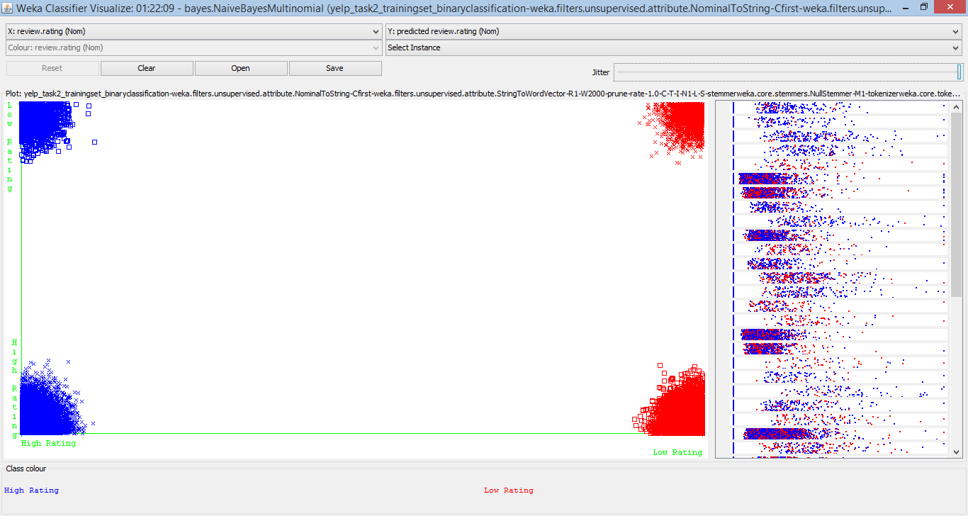
Task 2 – Results : Unigram (cont…)
Classification Error Graph for MultiNomial Naïve Bayes

Slide 18
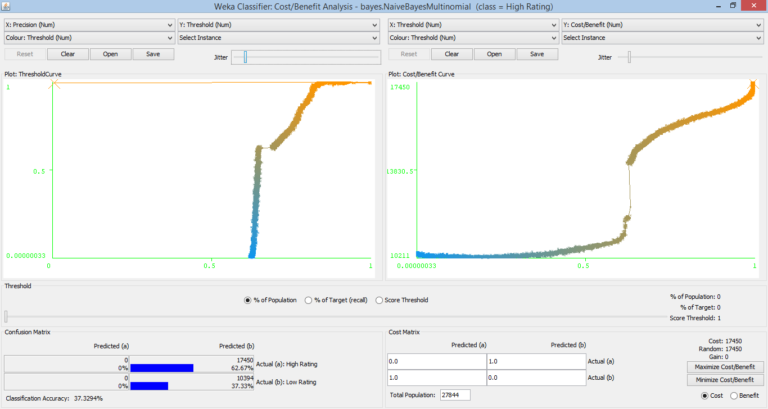
Task 2 – Results : Unigram (cont…)
Cost/Benefit Analysis For (High Rating) MultiNominal Naïve Bayes

Slide 19
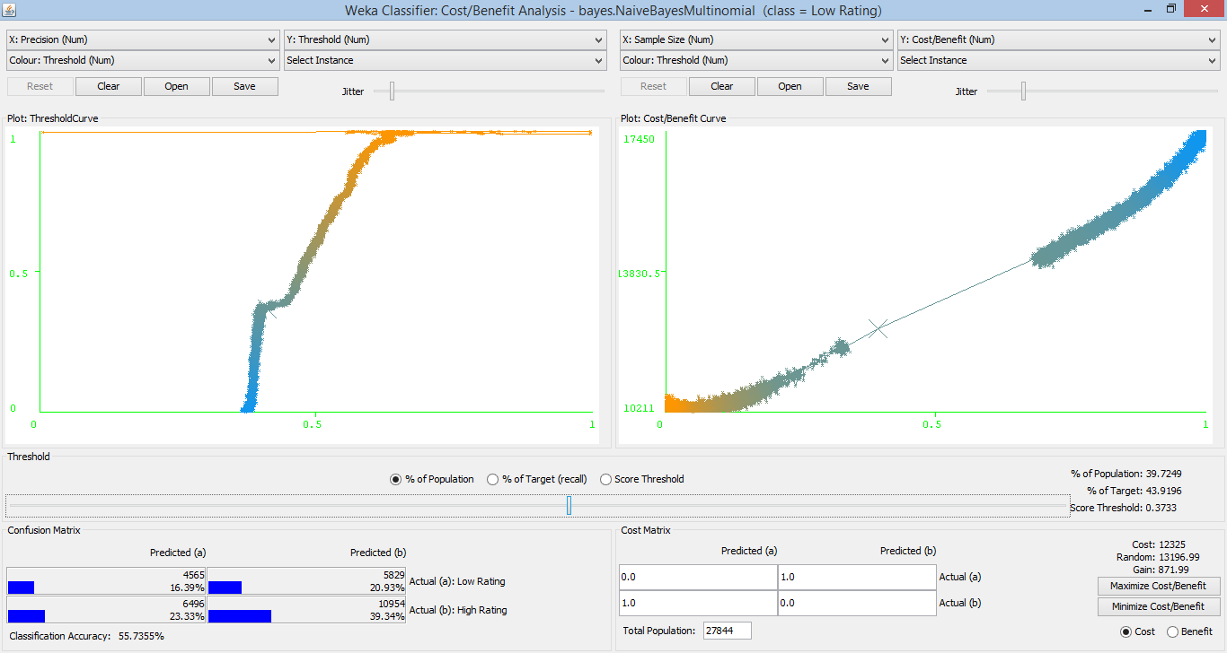
Task 2 – Results : Unigram (cont…)
Cost/Benefit Analysis For (Low Rating) MultiNominal Naïve Bayes

Slide 20
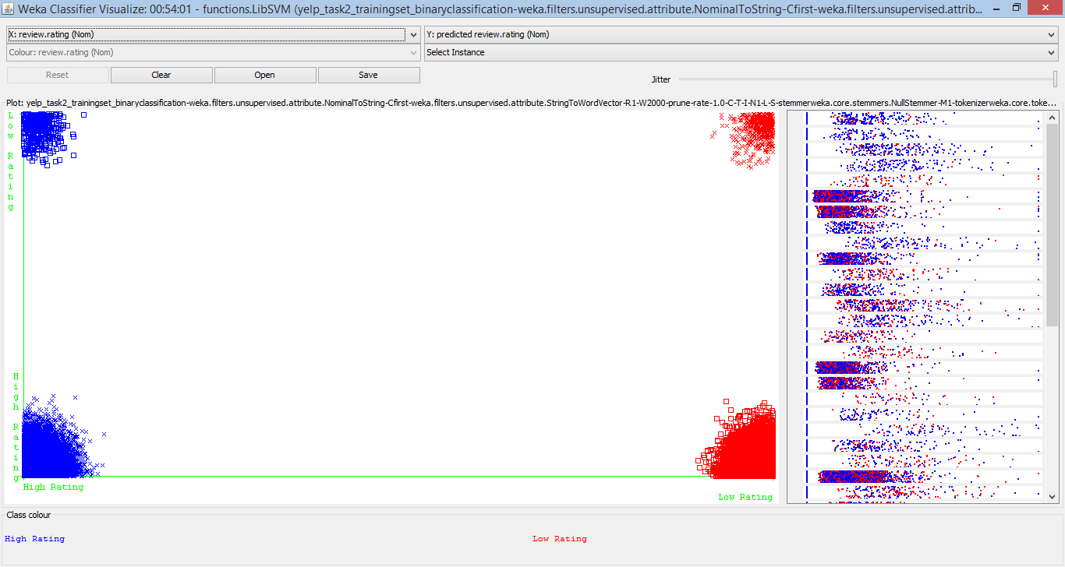
Task 2 – Results : Unigram (cont…)
Classification Error Graph for MultiNomial Naïve Bayes

Slide 21
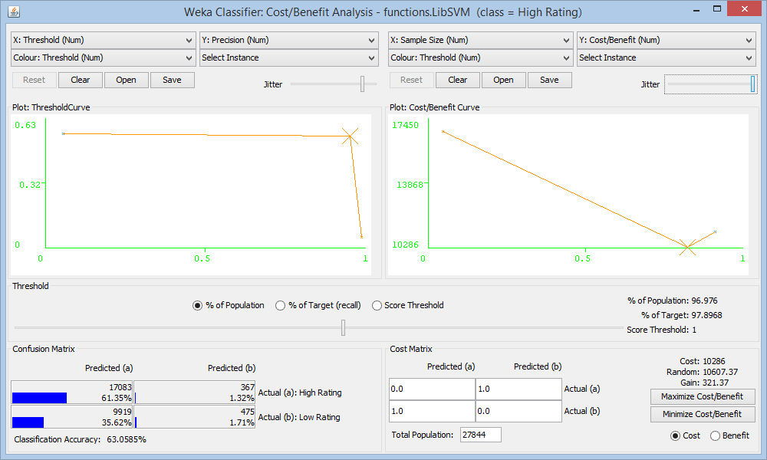
Task 2 – Results : Unigram (cont…)
Cost/Benefit Analysis For (High Rating) MultiNomial Naïve Bayes

Slide 22
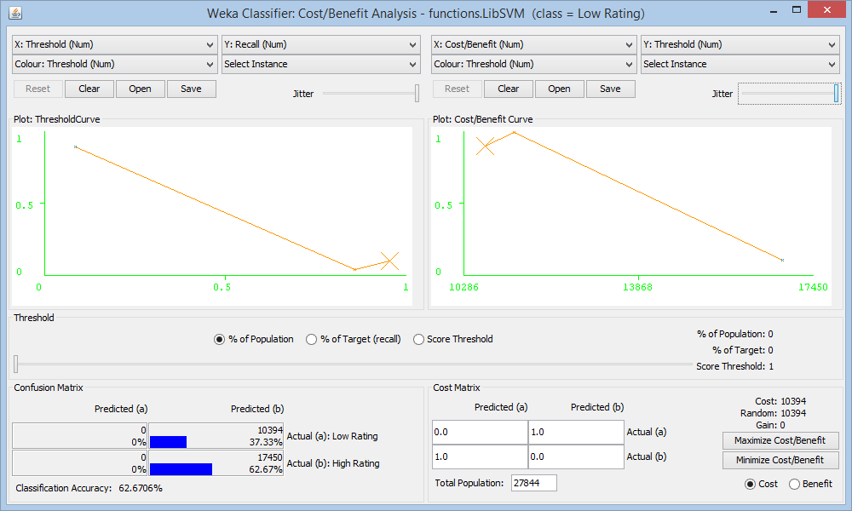
Task 2 – Results : Unigram (cont…)
Cost/Benefit Analysis For (Low Rating) MultiNomial Naïve Bayes

Slide 23
Task 2 – Results : Bigram
Instances: 27844 Attributes: 43
Multi Nomial Naïve Bayes
SVM
Results | Values
Accuracy | 61.8482 %
Precision | 0. 582
Recall | 0. 618
False Positives | 0. 549
True Positives | 0. 618
Results | Values
Accuracy | 63.4679 %
Precision | 0.636
Recall | 0.635
False Positives | 0.602
True Positives | 0.635

Slide 24
Task 2 – Results : Trigram
Instances: 27844 Attributes: 54
Multi Nomial Naïve Bayes
SVM
Results | Values
Accuracy | 63.001 %
Precision | 0.596
Recall | 0.630
False Positives | 0.593
True Positives | 0.630
Results | Values
Accuracy | 63.3925 %
Precision | 0.636
Recall | 0.634
False Positives | 0.605
True Positives | 0.634

Slide 25
Conclusion:
78% accuracy in predicting the categories, given a tip text for a selected set of 15 distinct categories for unigram.
63% accuracy in predicting low/ high performance ratings for a business, given the review results for unigram.
Future Work:
K- means clustering for task 1.
K- means clustering for task 2.
Task-1 Classifying with all categories
Limitations:
Memory constraints to run all the instances for task 1 and 2.

Slide 26
References
Ashraf M. Kibriya, Eibe Frank, Bernhard Pfahringer, and Geoffrey Holmes:
Multinomial Naive Bayes for Text Categorization Revisited.
Joachims, T: Text categorization with support vector machines: Leaning with many relevant features. In Proceedings of the Tenth European Conference on Machine Learning, Springer-Verlag (1998) 137-142
T. Mitchell. Machine Learning. McGraw-Hill, 1997.
Zhang, T., Oles, F.J.: Text categorization based on regularized linear classification methods. Information Retrieval 4 (2001) 5-31
http://www.ics.uci.edu/~vpsaini/files/technical_report.pdf
http://weka.wikispaces.com/Text+categorization+with+WEKA

Slide 27
Thank You

